Slide 1

The Digital Downconverter
Rodney Staggers Jr
Ph.D. Student
Arizona State University

Slide 2
Description
This assignment explored how radio signals are processed, using a local oscillator mixer, low-pass filter, and downsampling, to isolate desired frequencies.

Slide 3
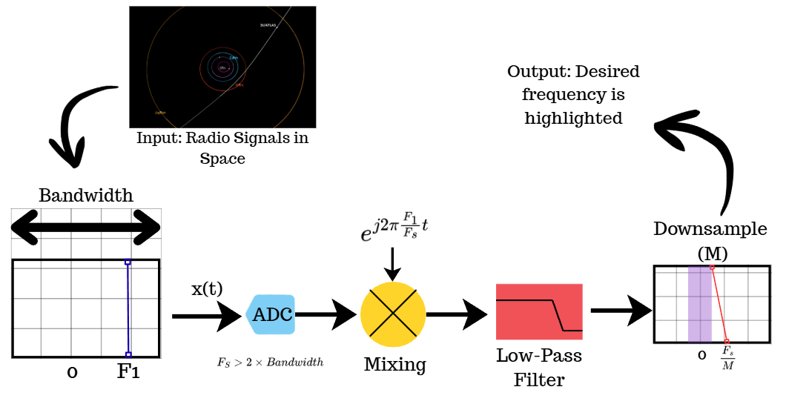
Digital Downconverter System Block Design

Slide 4
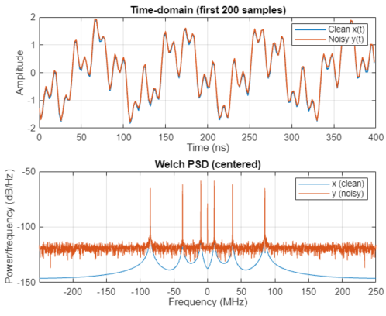
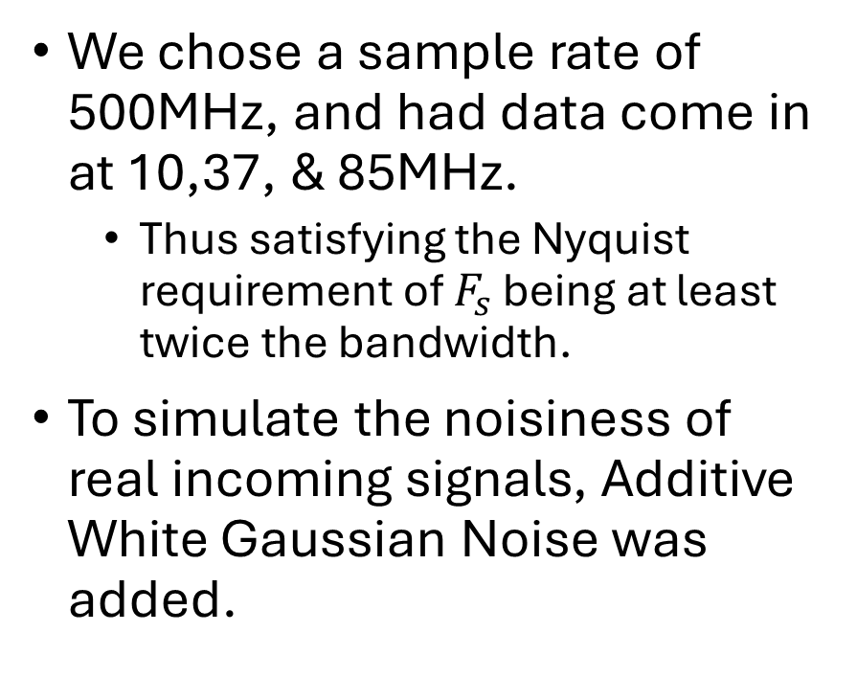
Incoming Frequencies
We chose a sample rate of 500MHz, and had data come in at 10,37, & 85MHz.
  Thus satisfying the Nyquist requirement of $F_{s}$ being at least twice the bandwidth.
To simulate the noisiness of real incoming signals, Additive White Gaussian Noise was added.

Slide 5
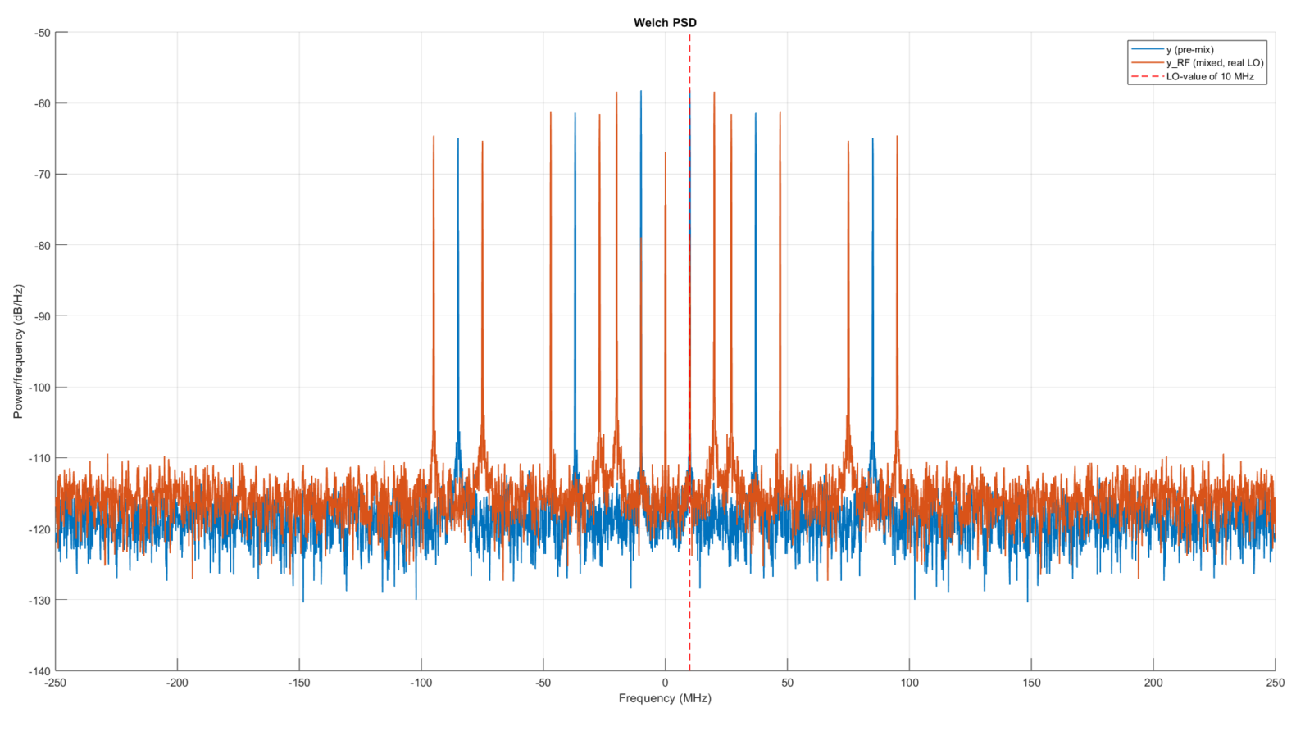
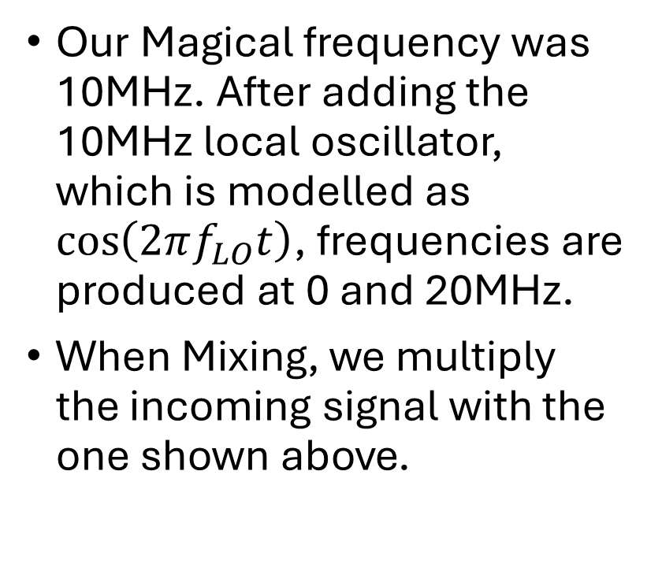
Mixing Stage
Our Magical frequency was 10MHz. After adding the 10MHz local oscillator, which is modelled as $\cos\left(2πf_{LO}t\right)$, frequencies are produced at 0 and 20MHz.
When Mixing, we multiply the incoming signal with the one shown above.

Slide 6
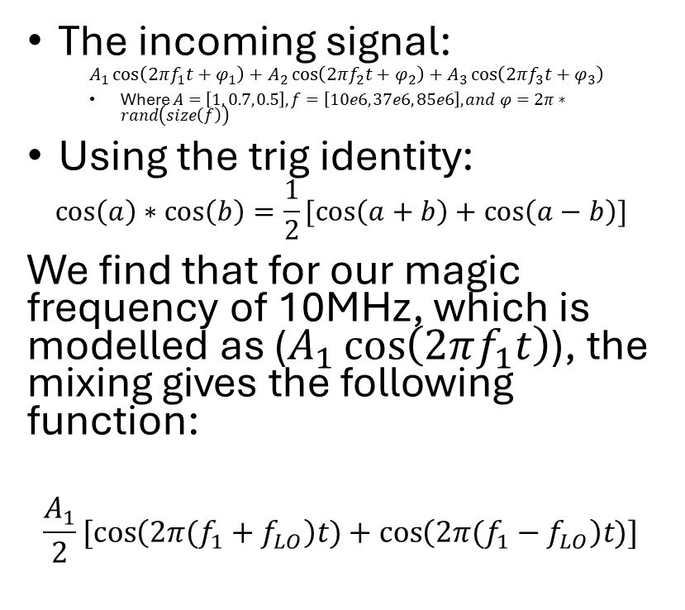
Mixing Stage
The incoming signal:
  $$A_{1}\cos\left(2πf_{1}t+φ_{1}\right)+A_{2}\cos\left(2πf_{2}t+φ_{2}\right)+A_{3}\cos\left(2πf_{3}t+φ_{3}\right)$$
  Where $A=\left[1, 0.7, 0.5\right], f=\left[10e6, 37e6, 85e6\right], and φ=2π∗rand\left(size\left(f\right)\right)$
Using the trig identity:
$$\cos\left(a\right)∗\cos\left(b\right)=\frac{1}{2}[\cos\left(a+b\right)+\cos\left(a−b\right)]$$
We find that for our magic frequency of 10MHz, which is modelled as ($A_{1}\cos\left(2πf_{1}t\right)$), the mixing gives the following function:
$$\frac{A_{1}}{2}[\cos\left(2π(f_{1}+f_{LO}\right)t)+\cos\left(2π(f_{1}−f_{LO}\right)t)]$$

Slide 7
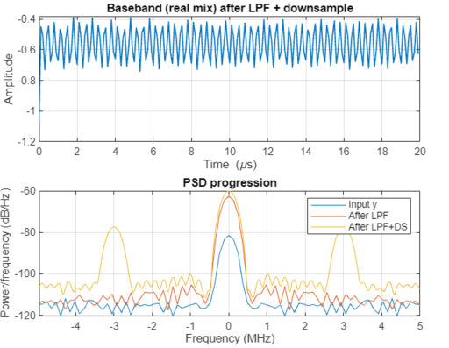
Low Pass Filter and Downsample
After going through the LO-mixer, we apply a 2MHz low-pass filter to remove everything above that. Since the baseband difference frequency for our magical frequency was 0MHz, and all other frequencies range from 10-95MHz, this will leave just one lone tone.

Slide 8
Low Pass Filter and Downsample
We subsequently apply a downsample of 50, reduces the original bandwidth to 2MHz and the new sample rate to 10MHz.

Slide 9
What I learned
The exploration process enhanced my repertoire in filtering out noisy datasets to isolate areas of interest, while also saving computational costs.

